Slide 1
Introduction to Apache Camel Framework
Apache Camel is a versatile open-source integration framework based on known Enterprise Integration Patterns (EIP).
At the core of the Camel it is a routing engine which empowers us to define routing and mediation rules in a variety of domain-specific languages (DSL), including a Java-based Fluent API, Spring or Blueprint XML Configuration files.
Camel uses URI based approach to refer to endpoints with more than 280 components supported, it allows camel to connect various transports, messaging model such as HTTP, ActiveMQ, JMS, CXF, as well as pluggable Components and more than 350 built in type converters.
Camel provides support for Bean Binding and seamless integration with popular frameworks such as CDI, Spring and Blueprint.
Camel provides out of box solution to more than 100 flexible and powerful Enterprise Integration Patterns which can be a simple or complex integration problems faced while developing and integrating real time applications.
Camel supports various Languages to create an Expression or Predicate within Routing DSL or the XML Configuration, some examples includes Bean Language for using Java based expressions, Constant, Header, JSonPath, XPath, XQuery, Simple, Spring Expression Language etc..

Slide 2
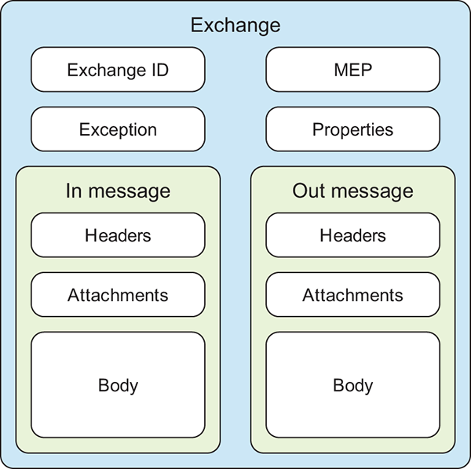
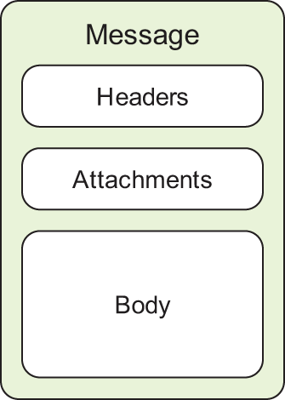
Core Concepts in Apache Camel framework
Camel message model consists of two abstractions Message and Exchange.
Messages are the entities used to communicate data from one system to another when using messaging channels. Messages flow in one direction, from a sender to a receiver consists of a body (a payload), headers, and optional attachments.
The body is of type java.lang.Object, so a message can store any kind of content and any size.
Headers are values associated with the message in the form of name-value pairs; the name is a unique, case-insensitive string, and the value is of type java.lang.Object.
An exchange in Camel is the message’s container during routing, it also provides support for the various types of interactions between systems, also known as message exchange patterns (MEPs). MEP’s are used to differentiate between one-way and request-response messaging styles.

Slide 3
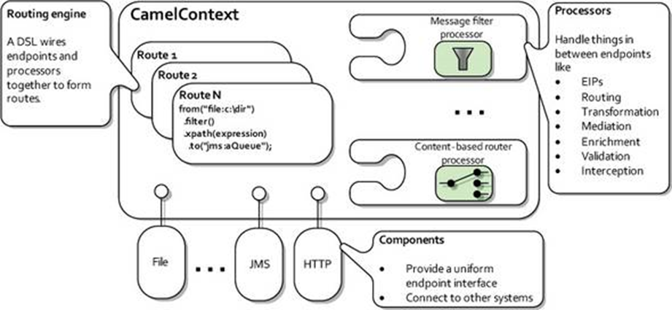
Core Concepts in Apache Camel framework
At a high level Camel consists of a runtime CamelContext which is responsible for managing collection of Component instances , Set of processors, Type converters, Route builder(s) integrated in same context.
A Component is essentially a factory of Endpoint instances which can be referenced with prefixes ex: <jms:>, <kafka:>, <file:>,<log:>, <direct:>, <seda:> etc..
Apache Component provides various references that offers services for messaging, sending data, notifications and various other services that can not only resolve easy messaging and transferring data but also provide securing of data.
Processors simply transform/modify/update incoming exchange(Consumer) and produce outgoing exchange(Producer) to next processor defined in the route.

Slide 4
Sample HTTP URL Route configuration(XML based)
<camelContext id="myContextXML“ xmlns=“http://camel.apache.org/schema/spring” >
<propertyPlaceholder id="properties" location="classpath:frameworkDev.properties"/>
<route id="route_Migrationflow">
<from uri="direct:MigrationStart"/>
<to uri="direct:inquiryEndpointStart"/>
<convertBodyTo type="java.lang.String" />
<log message="Install success with final response ${body}" />
</route>
<route id="route_inquiryEndpointSubflow">
<from uri="direct:inquiryEndpointStart" />
<setHeader headerName="CamelHttpMethod"><constant>POST</constant>
</setHeader>
<setHeader headerName="Content-Type"><constant>application/json</constant>
</setHeader>
<to id="caseInquiryEndpoint" uri="{{retreiveInquirydata.url}}" />
</route>
</camelContext>

Slide 5
Sample HTTP URL Route configuration(XML based)
Above Camel context example defines multiple routes using direct component for synchronous invocation of HTTP url defined by the property uri="{{retreiveInquirydata.url}}".
When any producer sends a message body it is mapped to HTTP request body and HTTP headers are set by using constant expression language semantics:
<setHeader headerName="CamelHttpMethod">
<constant>POST</constant>
</setHeader>
It is also worth noting that using <propertyPlaceholder> tag we can reference any custom application property dynamically within camel route where it has actual HTTP url defined.
By default logging component provided by camel can be configured to obtain necessary information coming in message headers/body evaluated using simple expression language semantics as illustrated in example:
<log message="Case Install success in BSP with final response ${body}" />
Finally an important implicit type converter is used in example which converts ResponseOutputStream coming from HTTP resource into a final output formatted as json string without explicit code changes:
<convertBodyTo type="java.lang.String" />

Slide 6
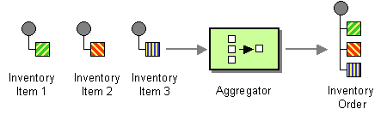
Aggregator Enterprise Integration Pattern (EIP)
The Aggregator is a standard EIP available out of box in the Apache Camel framework, which allows us to combine a number of messages together into a single message.
Mandatory elements needed for aggregator configuration:
A correlation Expression - this is a constant/dynamic expression evaluated by camel to determine the incoming messages which should be aggregated together.
An Aggregation Strategy - this is the aggregation logic which is executed by camel to combine all the message exchanges for a correlation key into a single message exchange.

Slide 7
Aggregate Route sample in Spring XML
<camelContext id="myContextXML“ xmlns=“http://camel.apache.org/schema/spring”>
<route id="route_AggregatorEnbflow">
<from uri="direct:AggregatorEnbStart" />
<log message="Sending ${body} with correlation key ${header.ENBAggregationKey} before aggregation" />
<aggregate strategyRef="enrollmentAndBalancingAggregationStrategy“
aggregationRepositoryRef="jdbcAggregationRepository">
<correlationExpression>
<header>ENBAggregationKey</header>
</correlationExpression>
<log message="Final Result - Sending out ${body}" />
</aggregate>
</route>
</camelContext>

Slide 8
Aggregator Configuration options
The Aggregator provides multiple options for configuring the route, following section describes most common and frequent elements used in configuring Aggregator.
correlationExpression - A correlation Expression is used to determine the messages which should be aggregated together based on correlation key. It will be evaluated to unique key on incoming message exchange to group all the messages together.
completionSize - Number of messages aggregated before the aggregation is marked complete for given correlation key. This option can be set as either a fixed value or using an Expression which allows us to evaluate a size dynamically, will use Integer as result.
completionPredicate - Bean reference which implements Predicate interface , this contains Boolean logic when an current aggregated exchange is marked complete/or not complete for a given correlation key.
If this option is not specified explicitly and the aggregationStrategy object implements Predicate interface, the aggregationStrategy object will be used as the completionPredicate.
completionTimeout - Time in milliseconds that an aggregated exchange should be inactive before its complete (timeout). This option can be set as either a fixed value or using an Expression which allows us to evaluate a timeout dynamically, will use Long as result.

Slide 9
Aggregator Configuration options
strategyRef - Sets the Strategy bean reference in the Registry(ex: Spring bean container) which is used to merge the incoming Exchange with already existing merged exchanges.
Aggregation Strategy is a core interface provided by camel with below method signature:
public Exchange aggregate(Exchange oldExchange, Exchange newExchange);
At first call the oldExchange parameter is null. On subsequent invocations the oldExchange contains the merged exchanges and newExchange is of course the new incoming Exchange.
Sample code snippet below with simple string concatenation on incoming message body to produce aggregated message exchanges:
public Exchange aggregate(Exchange oldExchange, Exchange newExchange) {
if (oldExchange == null) {
return newExchange;
}
String oldBody = oldExchange.getIn().getBody(String.class);
String newBody = newExchange.getIn().getBody(String.class);
oldExchange.getIn().setBody(oldBody + "+" + newBody);
return oldExchange;
}

Slide 10
Aggregator Configuration options
aggregationRepositoryRef – Sets the custom AggregationRepository bean reference in Registry (ex: Spring bean container) to use for managing merged exchange data in form of bytes(BLOB). If this option is not specified explicitly by default camel uses MemoryAggregationRepository which is an in memory repository.
JdbcAggregationRepository is one of the widely used variant of AggregationRepository interface which persists the aggregated messages on the fly into given repository configured with below parameters:
Bean reference for PlatformTransactionManager
Bean reference for DataSource
Repository name to be used
By default the aggregation and the aggregation completed two tables are needed , conventionally the completed table will have same name as the aggregation one suffixed with "_COMPLETED“.
Sample code snippet below with “aggregationRepo” and “aggregationRepo_COMPLETED” tables configuration:
public JdbcAggregationRepository jdbcAggregate() {
return new JdbcAggregationRepository(txManager(), "aggregationRepo", dataSource());
}

